Slide 1
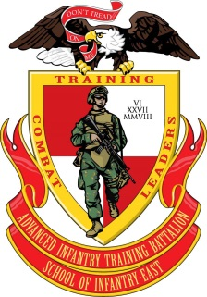
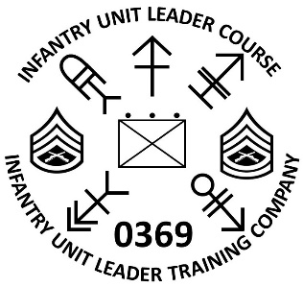
1. The intent of Infantry Unit Leader Course (IULC) is to develop leaders who have the will and knowledge to take decisive action in an uncertain environment, within the commander's intent. IULC is designed to be performance-oriented, focusing on the student's ability to think critically and to make acceptable decisions by applying sound fundamental principles that are captured in our infantry doctrine. The course seeks to train, develop, and produce an infantry leader confident in their ability to make sound tactical decisions when placed in scenarios progressing in complexity and design.
2. 0300 T&R events
03XX-COND-1001 03XX-FSPT-2001
03XX-NAV-1002 03XX-RFL-1001
03XX-C2-1001 03XX-GRLA-1001
It is recommended that students attending this course be evaluated on these events within six months of the course convene date. Prospective students should put additional emphasis on land navigation (plotting and map work) and operational terms and graphics (ref. JP 1-02, MIL-STD 2525D, NOT MCRP 5-12A). Students will be evaluated via Performance Evaluation Checklist on the following items on check in day: M4/M27 Service Rifle, M320A1 Grenade Launcher, M32 Grenade Launcher, M72 Light Anti-tank Weapon (LAW) and the M136 AT-4 Rocket Launcher.
RECOMMENDED MARINENET TRAINING:
MCIZ2540AZ Communications Plan and Orders
MCIZ0382ZZ Infantry Sqd Ldr: Weapons & Fire Support
REFERENCES:
Operate VHF and UHF Field Radios Marine Rifle Squad MCRP 3-10A.3
Commander’s Tactical Handbook MCRP 3-30.7 Scouting and Patrolling MCTP 3-01A
Infantry Company Operations MCRP 3-10A.2
Marine Infantry Platoon MCRP 3-10A.2
The above listed MarineNet Training and references are encouraged for all students to familiarize themselves with these events within three months of attending IULC. Students need to be familiar with the following subjects: Plan for and employment of infantry supporting arms (Machineguns, Mortars, Anti-Armor), Integration of close air support, and fire support planning with a ground scheme of maneuver.
3. In addition to the T&R events, MarineNet Training and References listed, students should read and synthesize MCDP 1,1-0,1-3,1-4,5,6,7, Boyd by Col. John Boyd, and Passion of Command by B.P. McCoy. Though not evaluated directly, the pre-reading will feature prominently in leadership evaluations where the student will be expected to exercise critical thinking while applying the concepts from the books.
ADVANCED INFANTRY TRAINING BATTALION
SCHOOL OF INFANTRY – EAST
INFANTRY UNIT LEADER COURSE PREP-GUIDE

Slide 2
ADVANCED INFANTRY TRAINING BATTALION
SCHOOL OF INFANTRY – EAST
INFANTRY UNIT LEADER COURSE PREP-GUIDE
Emotional and professional maturity are essential to the successful completion of Infantry Unit Leader Course. Students will make significant tactical movements under load and will be observed and evaluated during conditions of enhanced physical and mental stress. Individual physical and mental fitness is a crucial aspect of successful completion of this course. It is vital that they behave in a manner befitting of a professional infantry leader.
4. This prep-guide intentionally mirrors the required Command Screening Checklist (CSC) but does not replace it. To be accepted to the course, students are required to physically possess the CSC on the convening date.
5. If there are any questions or concerns regarding eligibility or preparation for this course, please contact the course SNCOIC GySgt Branson at Office: (910) 449-2197, Cell: (318) 450-2615, Email: justus.branson@usmc.mil or Course Chief Instructor GySgt Stanislawski at Office: (910) 449-2195, Cell: (440) 865-9540, Email: mitchell.stanislawski@usmc.mil

